Slide 1

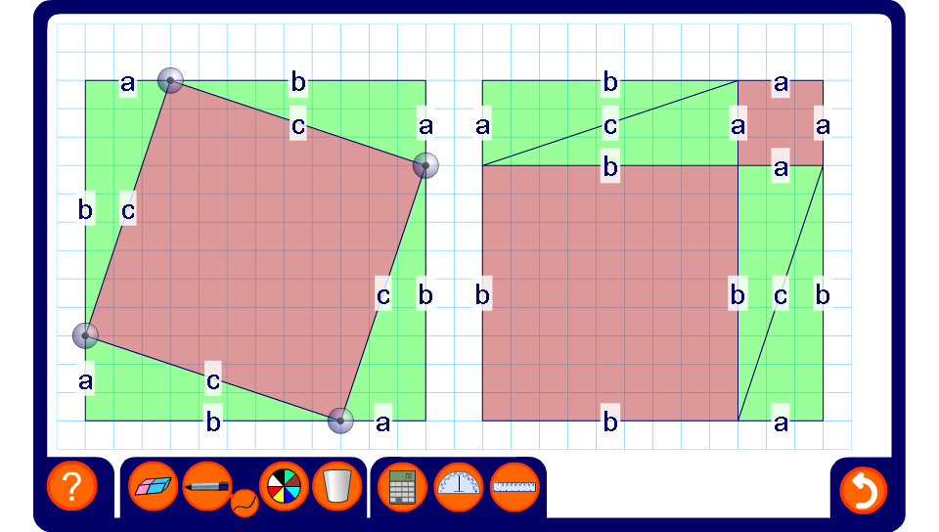


A proof of Pythagoras’ Theorem
Notes:
There many proofs of Pythagoras’s Theorem. Pupils could be asked to research these on the internet and make posters to show them.
In this proof we can see that the area of the two large squares is the same: (a + b)²
Both of these squares contain four identical triangles with side lengths a, b and c. In each of the large squares the four triangles are arranged differently to show visually that the area of the square with side length c is equal to the sum of the areas of the squares with side lengths a and b.
This can be shown more formally considering the first arrangement.
The area the red square with side length c is equal to the area of the large square with side length (a + b) minus the area of the four green right-angled triangles.
The area of the four green right-angled triangles is 4 × ½ab = 2ab.
c² = (a + b)² – 2ab
Expanding,
c² = a² + 2ab + b² – 2ab
c² = a² + b²

